Slide 1
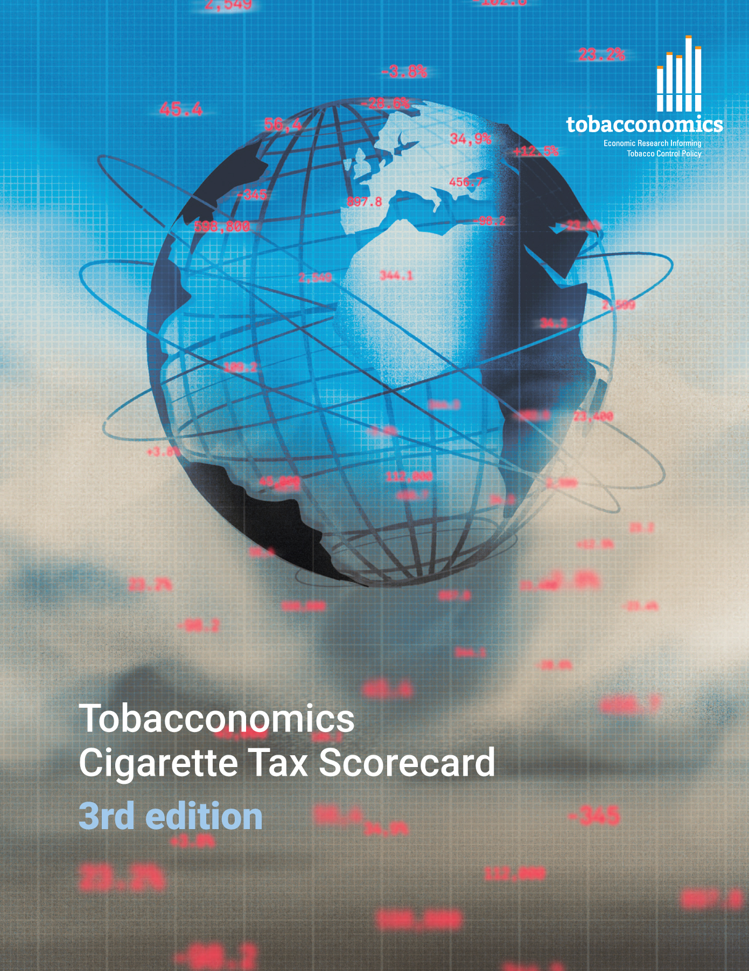
Cigarette tax policies in Democratic Republic of the Congo, 2022
4 key tax components were assessed using a 5-point scale, with the overall score reflecting an average of Democratic Republic of the Congo’s component scores.
The scores reflect the current strengths and opportunities in Democratic Republic of the Congo to further increase tax revenue and improve health.
OPPORTUNITY
for improvement
www.tobacconomics.org | @tobacconomics | Tobacconomics Cigarette Tax Scorecard (3rd edition)

Slide 2
How does Democratic Republic of the Congo compare to other countries?
Democratic Republic of the Congo’s overall score in 2022 is compared to the average overall scores in its income group, region, the world, and top performers.
www.tobacconomics.org | @tobacconomics | Tobacconomics Cigarette Tax Scorecard (3rd edition)

Slide 3
How does Democratic Republic of the Congo compare to other countries?
The components of Democratic Republic of the Congo’s score in 2022 are compared to component scores in the region, income group, world, and top performers.
CIGARETTE PRICE & AFFORDABILITY CHANGE
require the most improvement.
www.tobacconomics.org | @tobacconomics | Tobacconomics Cigarette Tax Scorecard (3rd edition)

Slide 4
Democratic Republic of the Congo’s cigarette tax policies over time
Democratic Republic of Congo's overall score slightly over the years due to an increase in tax share of price and improvement in the tax structure between 2016 and 2020.
www.tobacconomics.org | @tobacconomics | Tobacconomics Cigarette Tax Scorecard (3rd edition)

