Slide 1
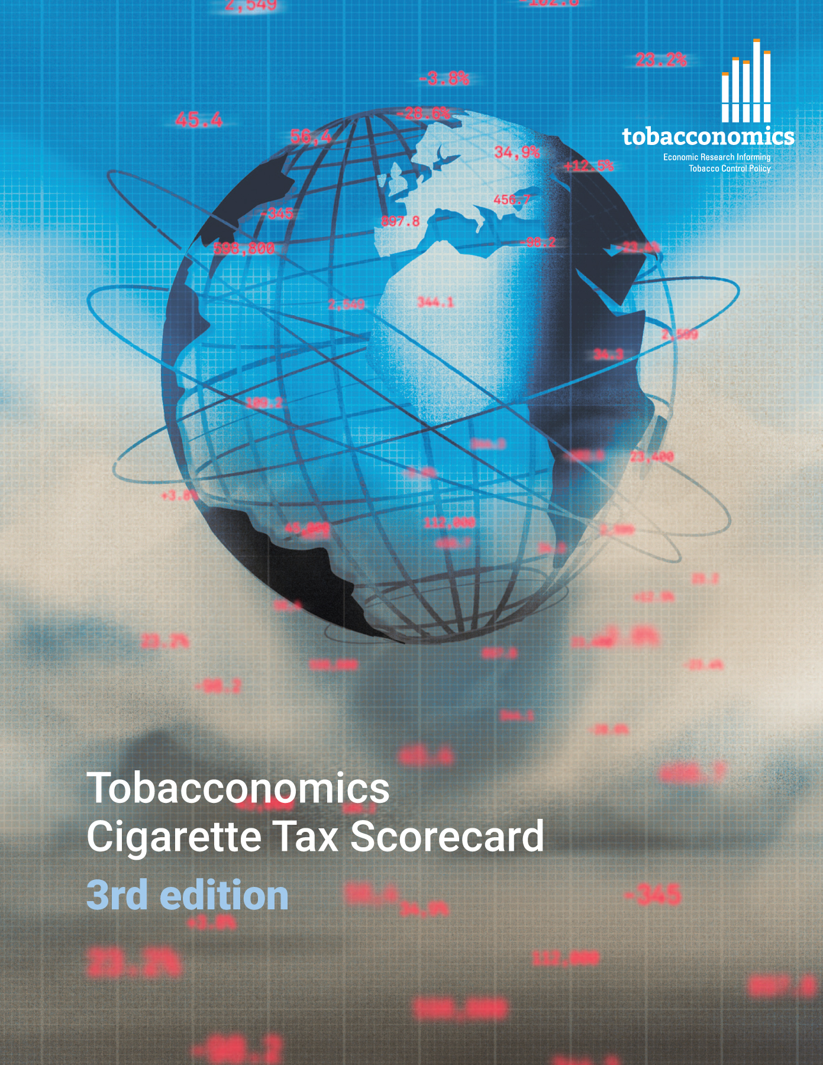
Cigarette tax policies in Angola, 2022
4 key tax components were assessed using a 5-point scale, with the overall score reflecting an average of Angola’s component scores.
The scores reflect the current strengths and opportunities in Angola to further increase tax revenue and improve health.
OPPORTUNITY
for improvement
www.tobacconomics.org | @tobacconomics | Tobacconomics Cigarette Tax Scorecard (3rd edition)

Slide 2
How does Angola compare to other countries?
Angola’s overall score in 2022 is compared to the average overall scores in its income group, region, the world, and top performers.
www.tobacconomics.org | @tobacconomics | Tobacconomics Cigarette Tax Scorecard (3rd edition)

Slide 3
How does Angola compare to other countries?
The components of Angola’s score in 2022 are compared to component scores in the region, income group, world, and top performers.
AFFORDABILITY CHANGE
& TAX SHARE
require the most improvement.
www.tobacconomics.org | @tobacconomics | Tobacconomics Cigarette Tax Scorecard (3rd edition)

Slide 4
Angola’s cigarette tax policies over time
Angola’s overall score increased sharply from 2018 to 2020 and dropped suddenly from 2020 to 2022, largely due to a failure to decrease in cigarette prices and affordability of cigarettes.
www.tobacconomics.org | @tobacconomics | Tobacconomics Cigarette Tax Scorecard (3rd edition)

